Slide 1



Slide 2
Voices of Youth for Better Engagement, Africa
Dream.Dare.Do
Welcome to VYBE, Africa we are:
A youth-led CBO in West Pokot County
Focusing on;
1. SRHR and maternal health
2. Climate change
3. Child Protection
4. Good Governance

Slide 3
Mission
A society where empowered youths inspire sustainable development, justice and well-being for all

Slide 4
Vision
To empower youths through capacity building, advocacy and community engagement, driving innovative solutions and policy influence across climate action, SRHR, Child protection and inclusive governance.

Slide 5
Goal
To empower youths to lead and shape a world where their voices are central to decision-making and positive change

Slide 6
Core Values
Integrity
Inclusivity
Accountability
Innovation
Respect for human rights
Environmental stewardship

Slide 7
SRHR and Maternal Health
Maternal health is a critical component of overall public health and a cornerstone of human development. It refers to the health of women during pregnancy, childbirth, and the postpartum period.
SRHR encompasses a broad range of services, information, and rights that enable individuals to have control over their own bodies, sexuality, and reproduction

Slide 8
Barriers to Access to quality SRHR
High rates of teenage pregnancy, early marriage, and FGM.
Limited youth-friendly services and trained health personnel.
Cultural taboos and stigma around sexuality and reproductive health.
Inadequate infrastructure and long distances to health facilities.

Slide 9
Why VYBE has focused on SRHR
Youth are disproportionately affected by poor SRHR outcomes.
Inclusive governance must include health rights and bodily autonomy.
Empowering young people with knowledge and services leads to healthier, more resilient communities.
SRHR is a gateway to gender equality and social justice.

Slide 10
What We Do as VYBE Africa
Train adolescent champions to lead peer education and advocacy.
Facilitate community dialogues to challenge harmful norms and promote rights.
Partner with health facilities to improve youth-friendly service delivery.
Use community scorecards and social accountability tools to monitor services.

Slide 11
Partner With VYBE for Better SRHR Outcomes
Support youth-led SRHR initiatives through funding and collaboration.
Advocate for inclusive, rights-based health policies at the county level.
Help us amplify the voices of young people in shaping their health futures.
Together, we can ensure that every young person in West Pokot has the right to health, dignity, and choice

Slide 12
Climate Action
Climate change is one of the most pressing challenges of our time, with far-reaching environmental, social and economic consequences.
Climate action refers to comprehensive efforts undertaken to combat climate change and its impacts.
Climate action is any measure, policy or program designed to reduce greenhouse gas emissions, build resilience to climate change impacts or support and finance these goals. It is a multi-faceted approach involving governments, businesses, communities and individuals working together to create a sustainable future.

Slide 13
Core components of climate action
Climate mitigation
Focuses on reducing the sources of greenhouse gas emissions e.g., deforestation and industrial processes.
Aims to stabilize greenhouse gas concentration in the atmosphere at a level that would prevent dangerous anthropogenic interference with the climate system, examples include, transitioning to renewable energy, improving energy efficiency and promoting sustainable land use.
2. Climate adaptation
Involves adjusting to the actual or expected impacts of climate change
Aims to reduce vulnerability and enhance resilience to the adverse effect of climate change.
Examples include, developing drought-resistant crops, building flood defenses and implementing early warning systems for extreme weather.

Slide 14
Key activities on climate action
1. Policy and governance
2. Sustainable land use and forestry
3. Circular economy and waste management
4. Climate finance and innovation
5. Public awareness and education

Slide 15
Inclusive governance
Definition
Inclusive governance refers to a system of decision-making where all stakeholders—regardless of their background, identity, or socioeconomic status—have a voice in shaping policies, laws, and institutional practices.

Slide 16
Core principles of inclusive governance
Transparency
Accountability
Participation
Rule of law
Responsiveness
Equity and inclusiveness
Effective and efficiency

Slide 17
Why VYBE Africa focuses on inclusive governance
Inclusive governance ensures that all voices—especially youth, women, and marginalized groups—are heard in decision-making.
It strengthens democracy, transparency, and accountability.
In West Pokot, exclusion has led to poor service delivery, inequality, and mistrust in institutions.

Slide 18
Barriers to Participation
Limited youth involvement in county planning and budgeting processes.
Cultural norms that sideline women and young people from leadership.
Weak civic education and low awareness of rights and responsibilities.
Inadequate platforms for citizen feedback and accountability.

Slide 19
How VYBE Africa Promotes Inclusive Governance
Civic education and awareness campaigns targeting youth and grassroots communities.
Training youth leaders on public participation, policy advocacy, and social accountability.
Facilitating community dialogues and town halls with local leaders.
Promoting the use of tools like community scorecards and public expenditure tracking.

Slide 20
Child Protection
Definition
Child Protection is about preventing and responding to violence, exploitation, abuse, and neglect against children. It ensures children grow up in a safe, nurturing, and protective environment where their rights are respected

Slide 21
Types of abuses
Sexual Abuse and Exploitation
Emotional/Psychological Abuse
Neglect (lack of basic needs, education, healthcare)
Child Labor & Trafficking
Harmful Cultural Practices

Slide 22
Why child protection matters to VYBE Africa
Child protection issues are deeply linked with SRHR (child pregnancies & child marriage)
Unique challenges that heighten the vulnerability of children in West Pokot:
1. Poverty and Food Insecurity
2. Harmful Cultural Practices
3. Limited Access to Services
4. Impact of Climate Change

Slide 23
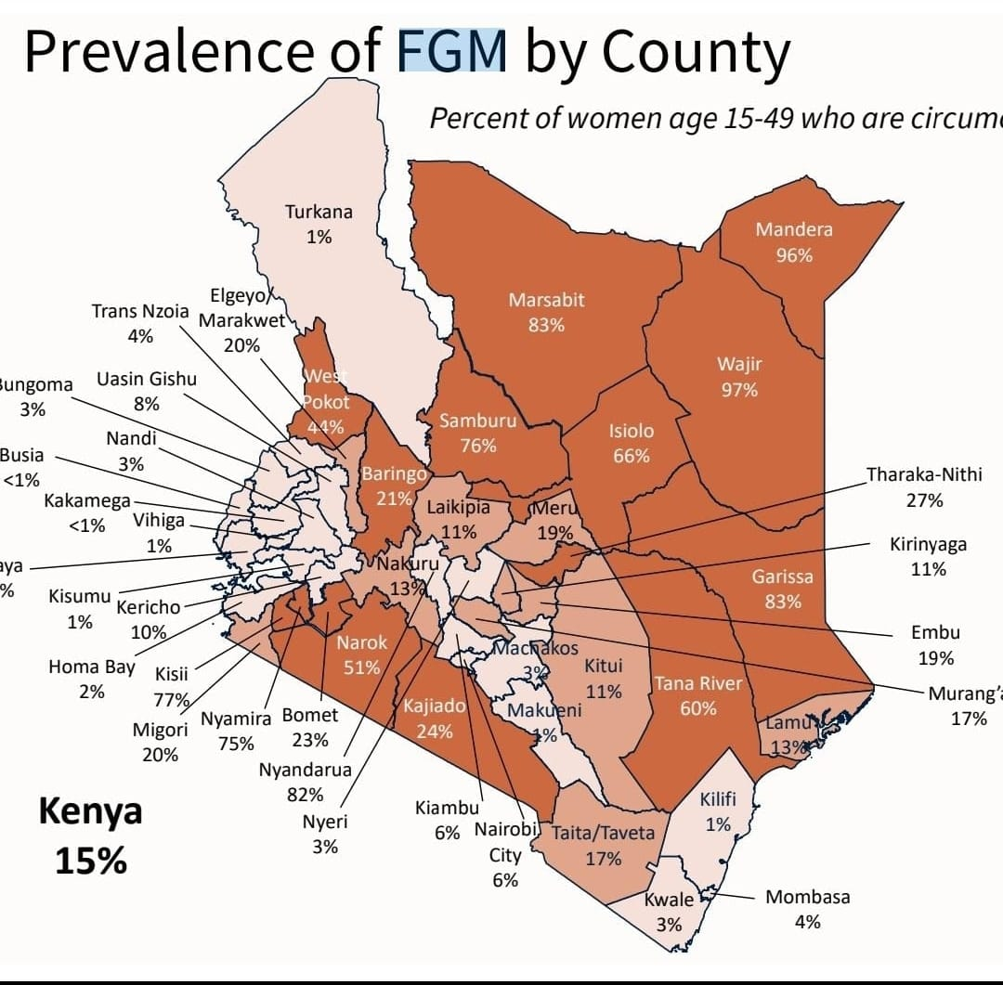
Child protection issues in West Pokot

Slide 24
Child Marriage & Teenage Pregnancy:
West Pokot historically has some of the highest rates of child marriage and teenage pregnancy in Kenya.
It is ranked 2nd nationally, with 36% of girls aged 15-19 pregnant or already mothers as of KDHS 2022(up from 29% in 2014), often linked to child marriage.
. Female Genital Mutilation (FGM):
Despite being outlawed, FGM remains a persistent, harmful cultural practice in parts of West Pokot, disproportionately affecting young girls.
Child Labor & Neglect:
Poverty and drought conditions contribute to children being withdrawn from school for labor (e.g., herding, mining, small-scale farming, domestic work).
. Inter-communal Conflict & Displacement
Though improving, historical cattle rustling and conflict in border areas have led to displacement, increasing children's vulnerability to injury, psychological trauma, and disrupted education.

Slide 25
Break the Silence
If you suspect a child is at risk, report it. Don't assume someone else will. Know who to contact:
Your local Children's Officer
The nearest Police Station (Child Protection Unit)
Trusted Community Leaders/Elders
"When we protect our children today, we are investing in a healthier, safer, stronger, and more engaged West Pokot for tomorrow."

Slide 26

Thank you!

